Slide 1



Auto Surveillance For
Security
Supervisor:
Dr. Hasan Mujtaba
Group Members:
Fateh Muhammad 19I-1750
Fahad Baig 19I-1883
Adeel Subhan 19I-1869

Slide 2

CONTENTS
Introduction Poster | Project Idea Poster
Progress | A progress update of our project modules.
Use Case Diagram | High-level functions and scope of our system
Suspicious Avtivity Detection | A working Demo of Suspicious Activity Model.
Implementation Details | Techniques used to Detect Loitering
User Interface Progress Maintenance | Web Page Update Maintenance of our Project

Slide 3
Project Idea
A customizable security application for homes and private properties [Scope reduced due to time constraints].
Suspicious Activity Detection.
Threat Detection.
Notifying User and Authorities accordingly.

Slide 4
Motivation & Problem Statement
To tackle the limited software solutions in surveillance system.
Notifying to User and Authorities before an atrocity happens.
Customizability according to user’s need

Slide 5
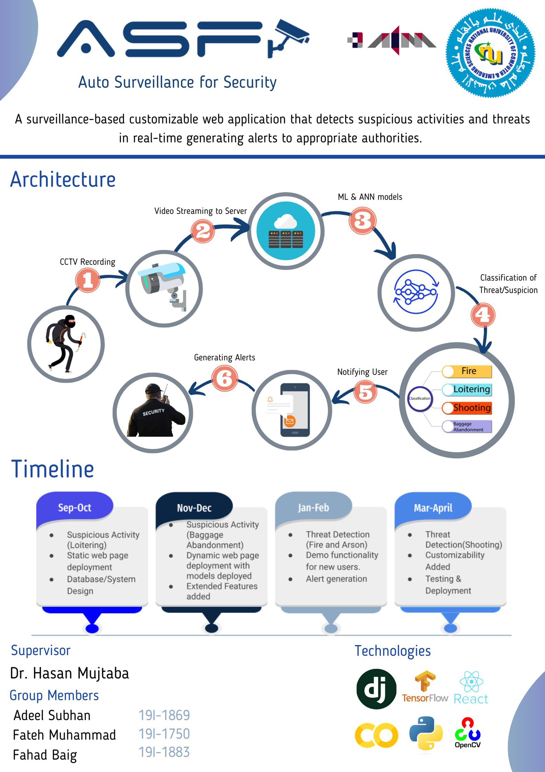
Poster

Slide 6
Progress
Development of FYP-I
Domain Research
Data Collection
Suspicious Activity [1/2]
Mid Evaluation
Web Interface [Iter 1]
Final Evaluation
Suspicious Activity [2/2]
Web Interface [Iter 2]
Integration

Slide 7
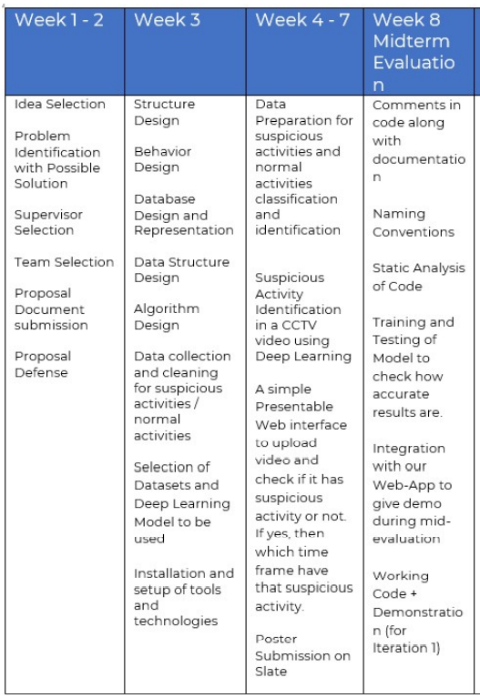
Progress w.r.t. Commitment
Commitment

Slide 8
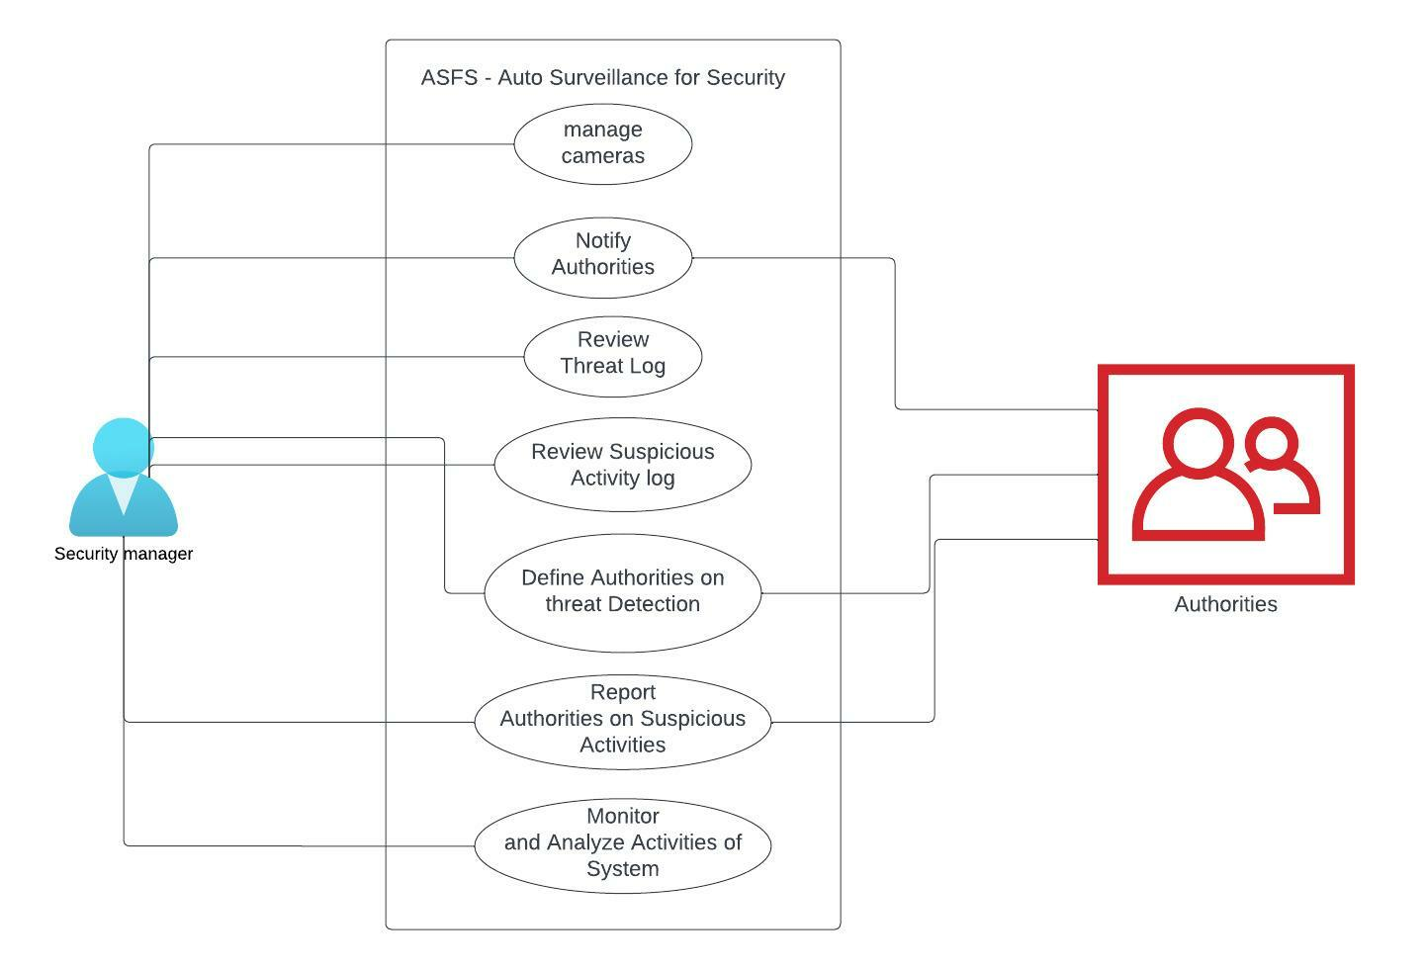
Use Case Diagram

Slide 9
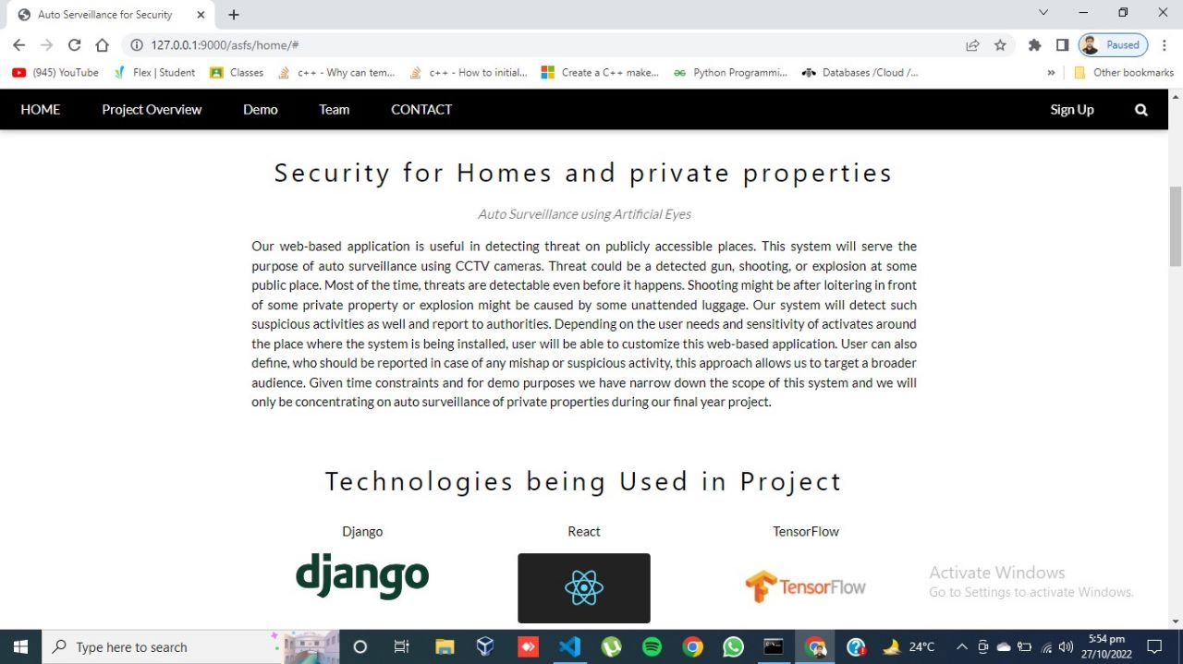
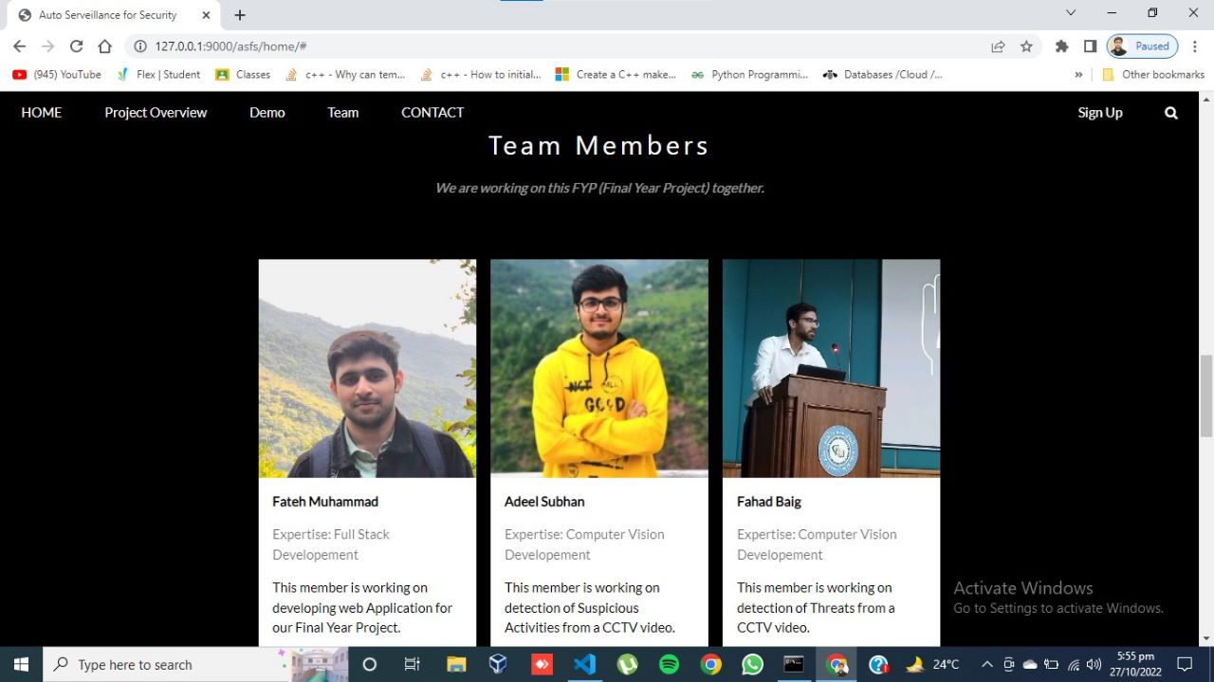
Web Application

Slide 10
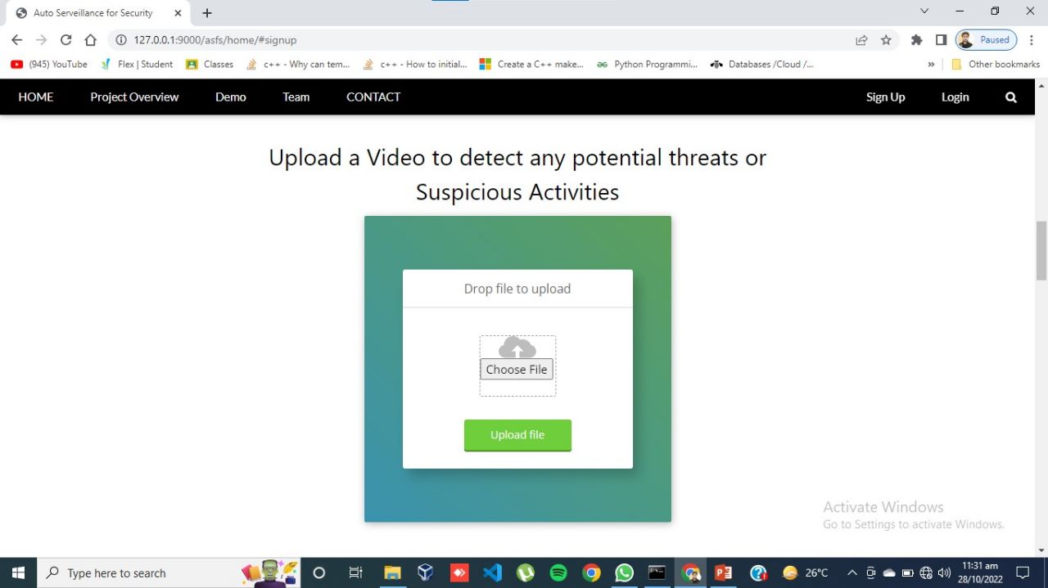
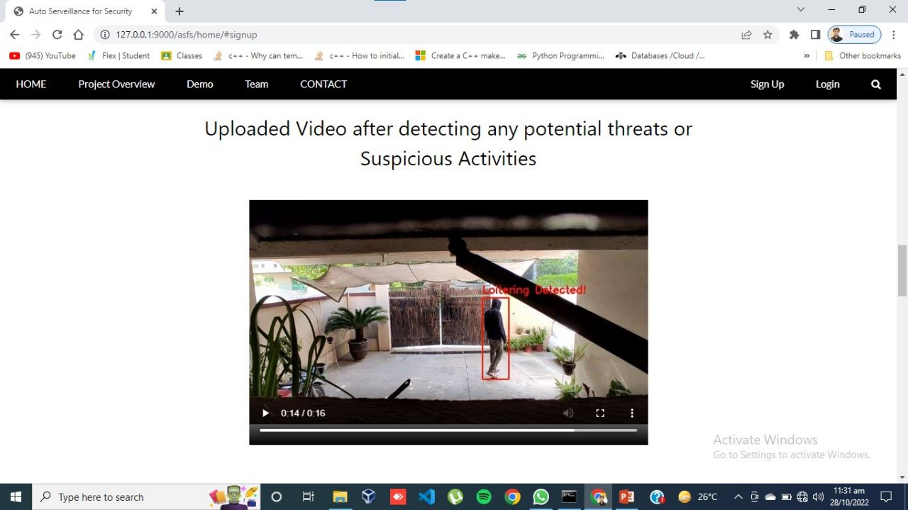
Prototype

Slide 11
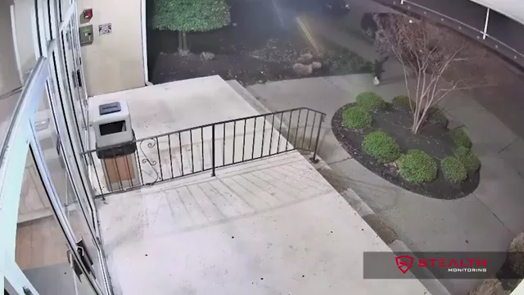
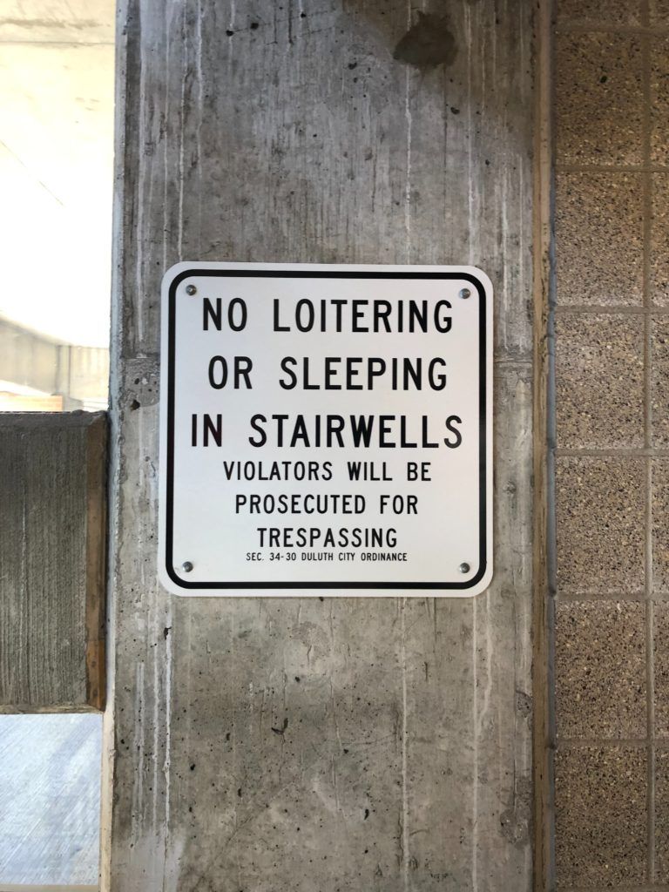
Suspicious Activity – 1 [loitering]

Slide 12
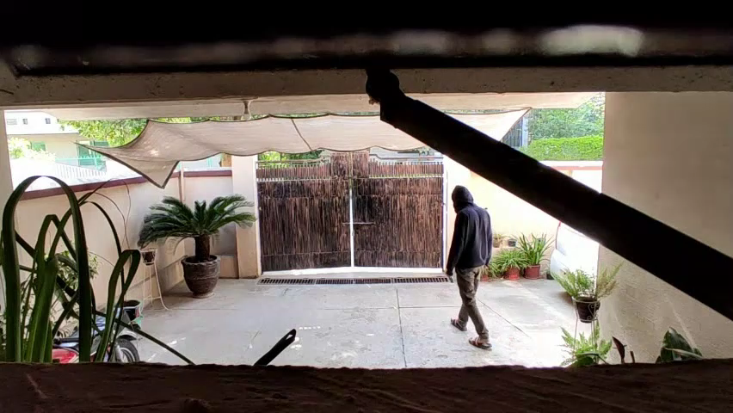
Results

Slide 13
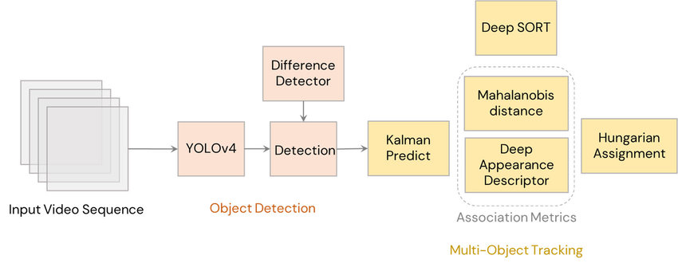
Implementation Details
YOLO for Object Detection
Deep Sort for Tracking of Objects
Custom State Dictionary for Loitering Detection

Slide 14
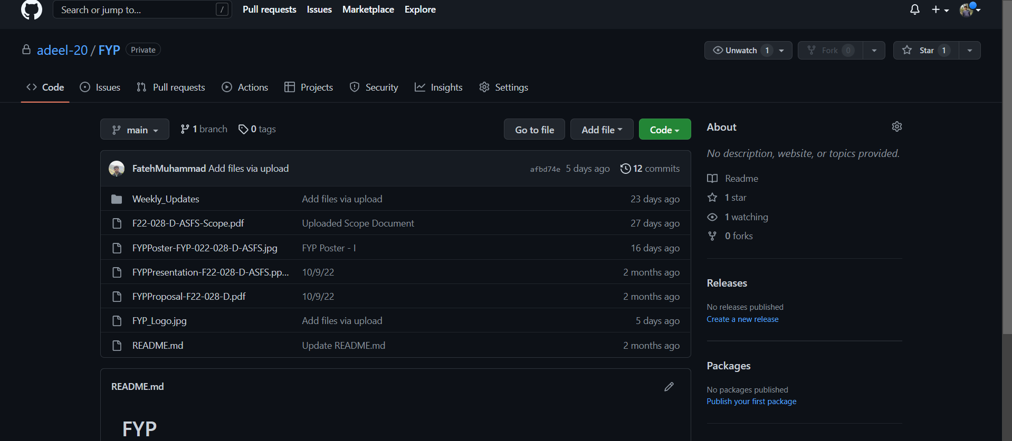
Maintenance

Slide 15
Thank you

